Slide 1
Router and Routing

Slide 2
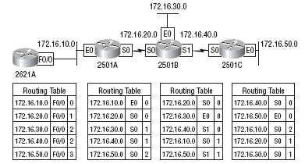
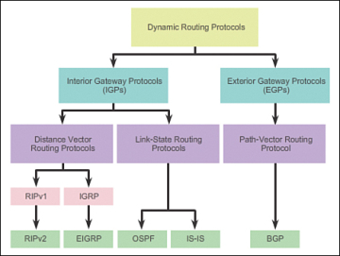
Routing: Key Aspects
Routing table
Routing algorithms

Slide 3
How Routers Learn about Routes?
Default routing
All routes send packets to a single router
Static routing
We manually add routes to the routing tables
Dynamic routing
Routers learn about routes from each other or because of broadcasts

Slide 4
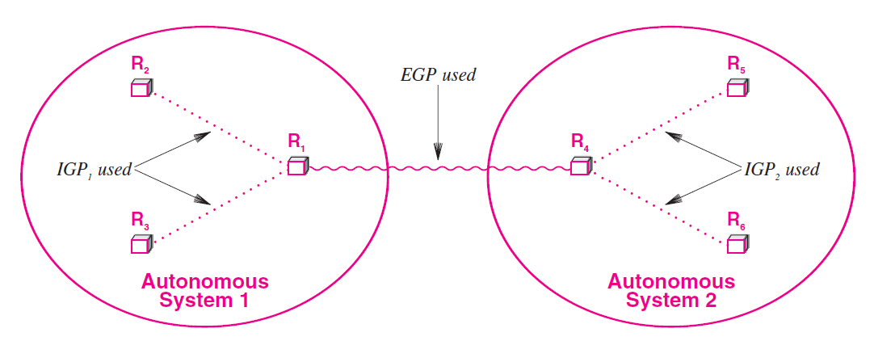
Interior and Exterior Gateway Protocols

Slide 5
Classes of Routing Protocols
Distance Vector Protocols (Example: RIP – Routing Information Protocol)
Use distance to measure the route cost
The number of hops between the router and a destination network establishes the distance
Regularly send their whole routing table to the remote routers
The receiving router then integrates its routing table with the received data based on the metrics
Link State Protocols (Example: OSPF – Open Shortest Path First)
Form a remote connection with other routers prior to sharing routing data
They don’t broadcast routing data to the whole network
Path Vector Protocols (Example: BGP – Border Gateway Protocol)
Works across interior networks, i.e. in an exterior network

Slide 6
Routing Information Protocol (RIP)
RIP routers use only routing tables to store information
RIP can store multiple routes to the same destination and uses as its metric a value called hop count
Hop count is the number of routers that are in the path to the destination network using that route
Broadcasts UDP data packets to exchange routing information
Cisco software sends routing information updates every 30 seconds, which is termed advertising
If a device does not receive an update from another device for 180 seconds or more, the receiving device marks the routes served by the non updating device as unusable
If there is still no update after 240 seconds, the device removes all routing table entries for the non updating device

Slide 7
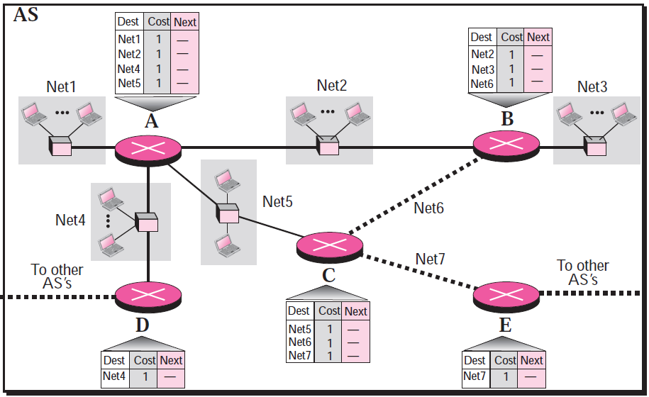
Distance Vector Routing Example – Step 1

Slide 8
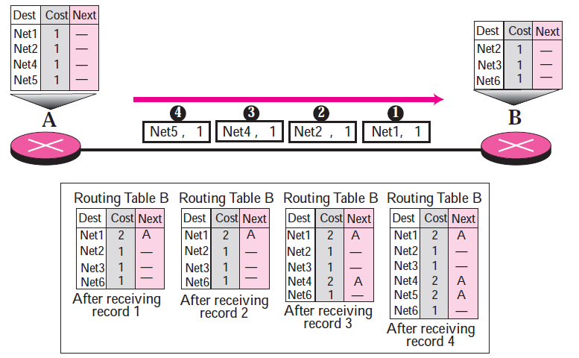
Distance Vector Routing Example – Step 2

Slide 9
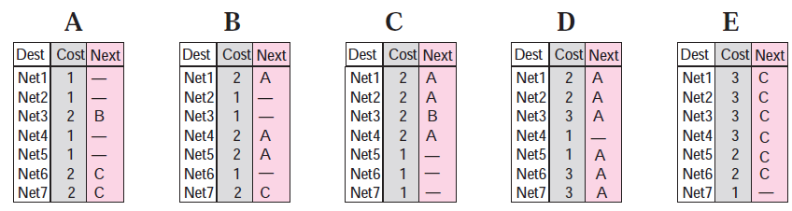
Distance Vector Routing Example – Step 3
More updates will be needed to fill the blanks/gaps …

Slide 10
Variations of RIP: IGRP and EIGRP
The Interior Gateway Routing Protocol (IGRP) is a distance-vector routing protocol.
IGRP has been superseded by Enhanced IGRP (EIGRP), which has many new features.
IGRP and EIGRP have a compound metric that takes into account several factors, such as link bandwidth and latency.
As such, IGRP is superior to RIP, which takes into account only the hop count, and RIPv2, which uses both hop count and bandwidth.
In addition to the compound metric, which allows better route selection, IGRP tends to have better convergence times, meaning that routing stabilizes more quickly after a network disruption.
Notes:
10

Slide 11
Drawbacks
IGRP and EIGRP are proprietary protocols, which means they are implemented only by Cisco routers.
IGRP (like RIP) broadcasts the entire routing table, which can consume a lot of network bandwidth
Notes:
11

Slide 12
IGRP versus EIGRP
EIGRP supports VLSM, IGRP does not
Path calculations are improved in EIGRP
EIGRP has less frequent updates as compared to IGRP
Notes:
12

Slide 13
OSPF
Open Shortest Path First (OSPF) is an industry-standard protocol that operates on non-Cisco routers also
Based on link-state routing
Detailed routing information about an area is confined to that area, and only a summary of information is advertised to other areas
This has the benefit of keeping OSPF routing tables smaller
RIP works fine in small networks, but not in large networks
When routers exchange information, it is called as flooding
Frequency of exchange is once in every 1-2 hours

Slide 14
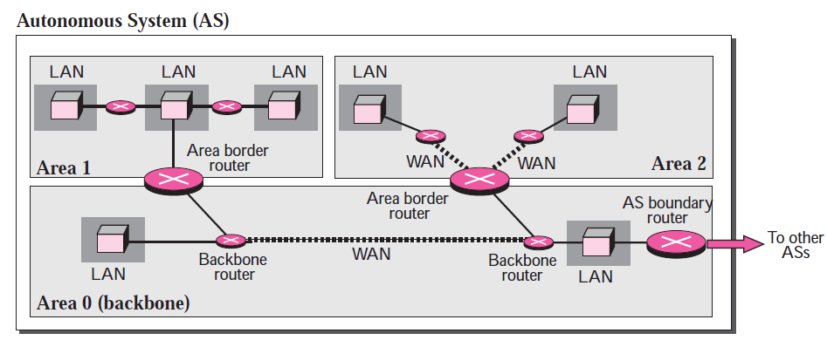
OSPF Area

Slide 15
Understanding OSPF
Two aspects: OSPF tables and OSPF packets
OSPF uses three tables
Neighbor Table: Information about neighbors
Topology Table: Information about other routers and networks in the AS
Routing Table
It uses five packets
Hello Packets
Database Descriptor (DBD)
Link State Request (LSR)
Link State Update (LSU) – Most important
Link State Acknowledgement (LSAck)

Slide 16
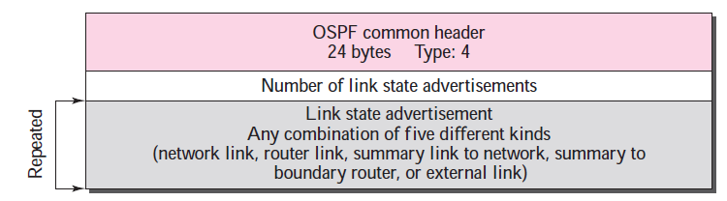
Link State Update Packet
Main packet, used by a router to advertise the state of its links
Format

Slide 17
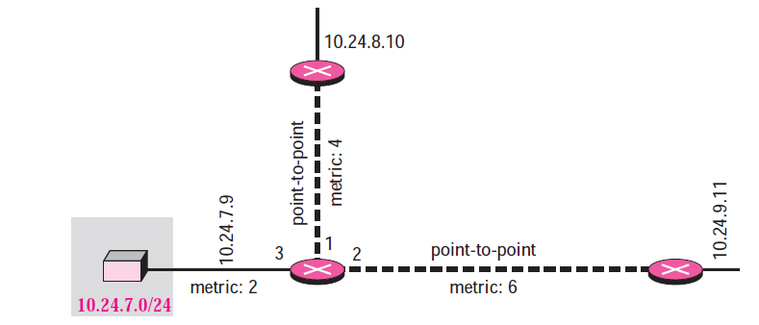
Link State Update – Example
What will be the LSA part of the Link State Update packet sent by router 10.24.7.9?

Slide 18
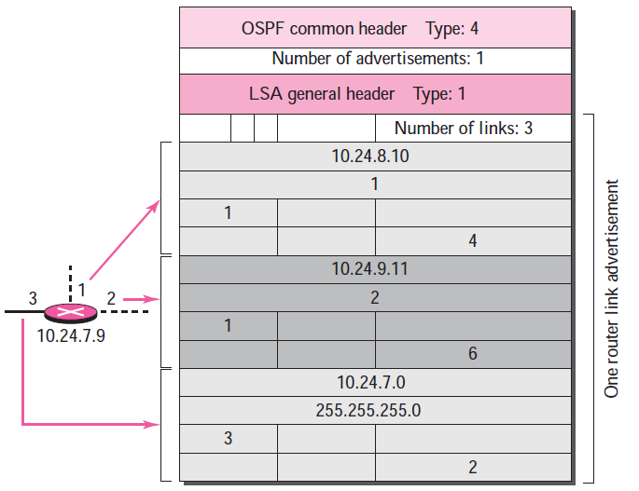
Link State Update – Example
1: It is about a router
3: It is about a network

Slide 19
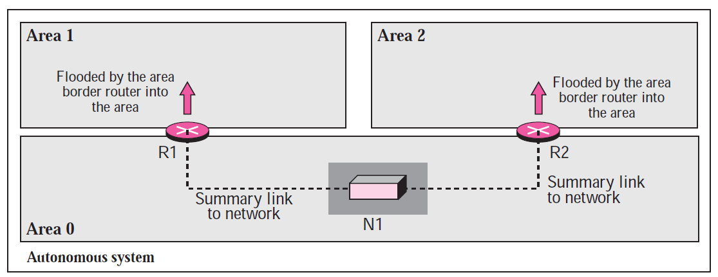
Flooding into the Neighbouring Areas

Slide 20
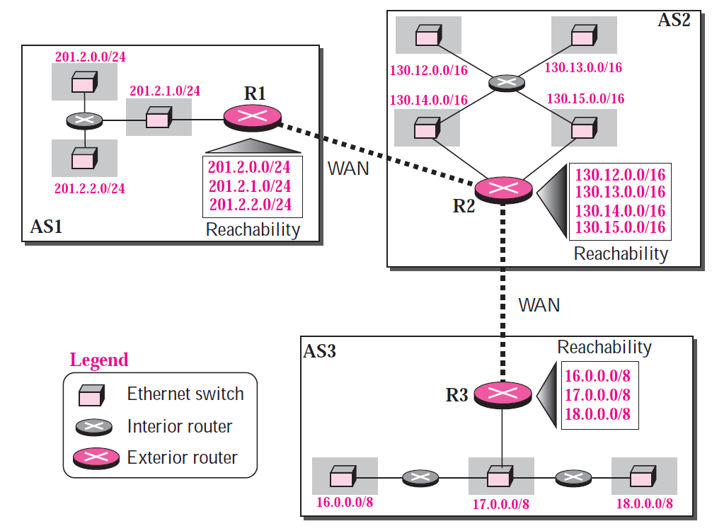
Path Vector Routing – Step 1
Each AS has at least one path vector routing that collects reachability information for each network in that AS

Slide 21
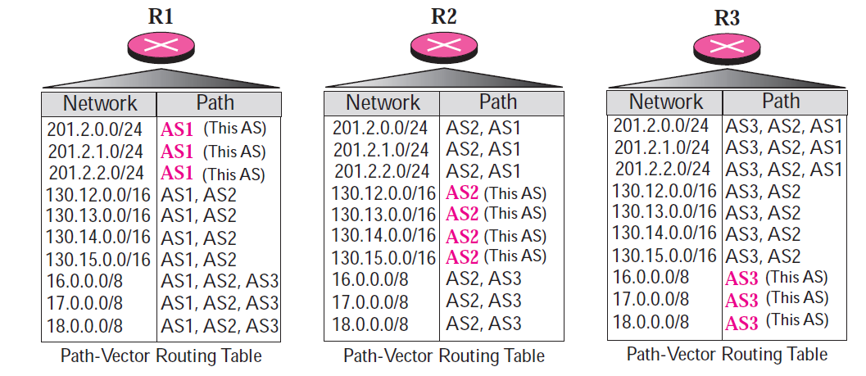
Path Vector Routing – Step 2
A path vector routing table for each router can be created if ASs share their reachability list with each other

